Slide 1
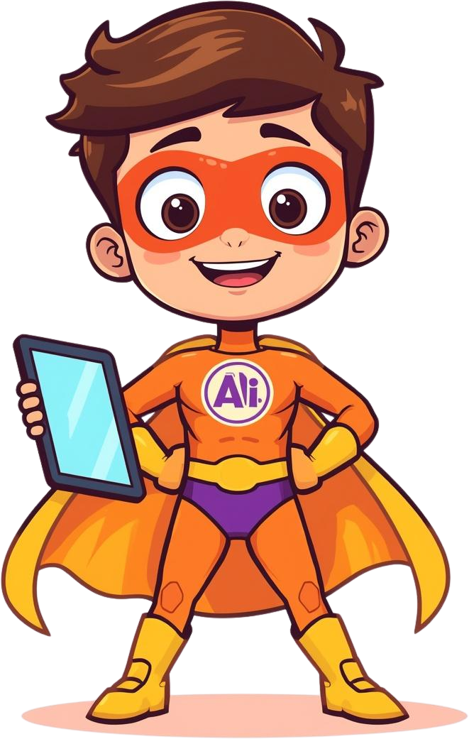
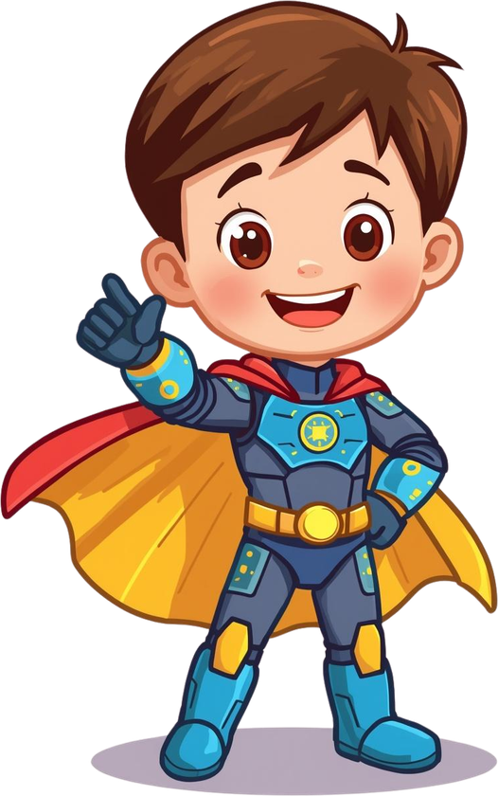
How to Use AI Responsibly and Stay Safe
Day 7: AI Superheroes
Ethics & Safety

Slide 2
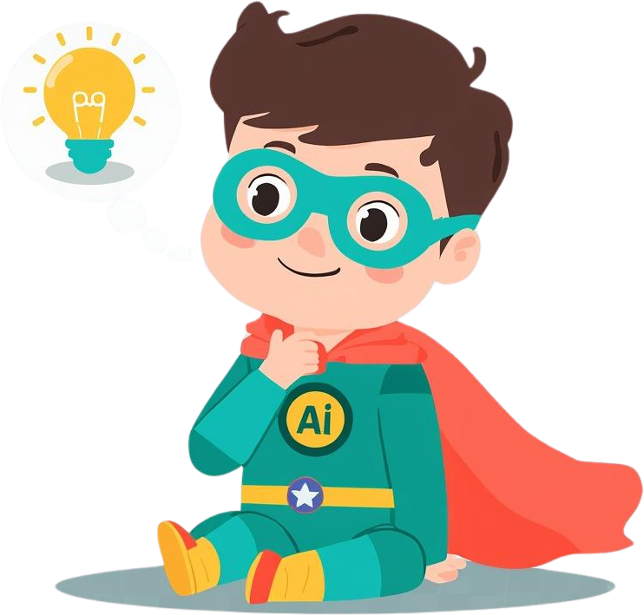

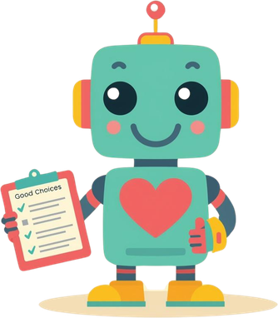


What is AI Ethics?
The Meaning
Our Values
AI Ethics means knowing the difference between right and wrong when using AI. It helps us make smart, kind, and fair choices with technology!
Fairness: Treat everyone equally
Honesty: Always tell the truth
Privacy: Keep secrets safe
Kindness: Be nice to others
Being an AI Superhero means using technology to help others and make good choices every day!

Slide 3
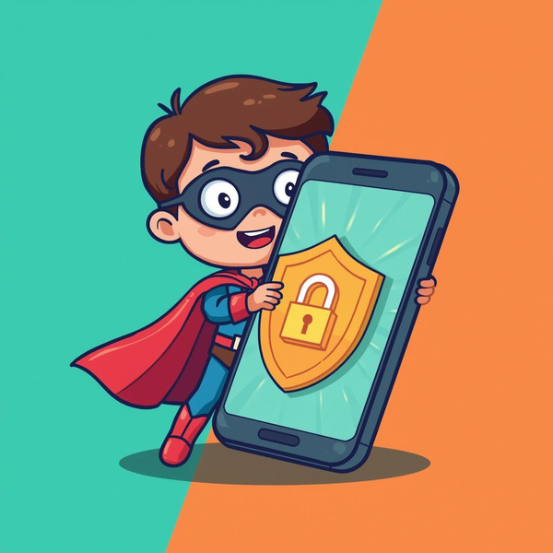
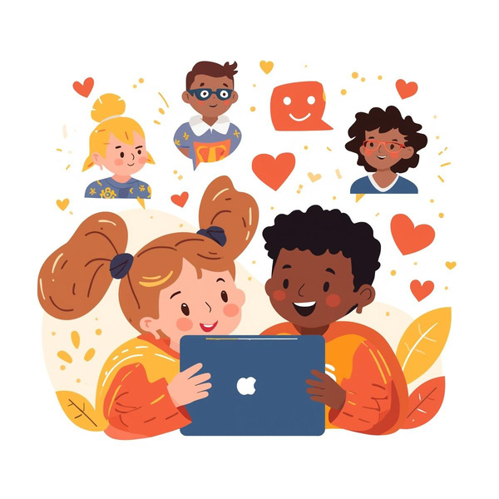
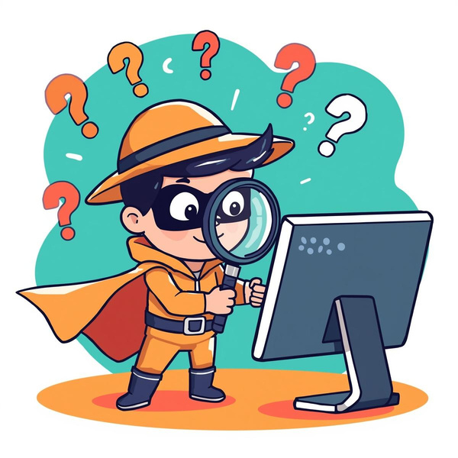
AI Ethics in Real Life
Protect Your Privacy
Be Kind Online
Spot Fake News

Slide 4
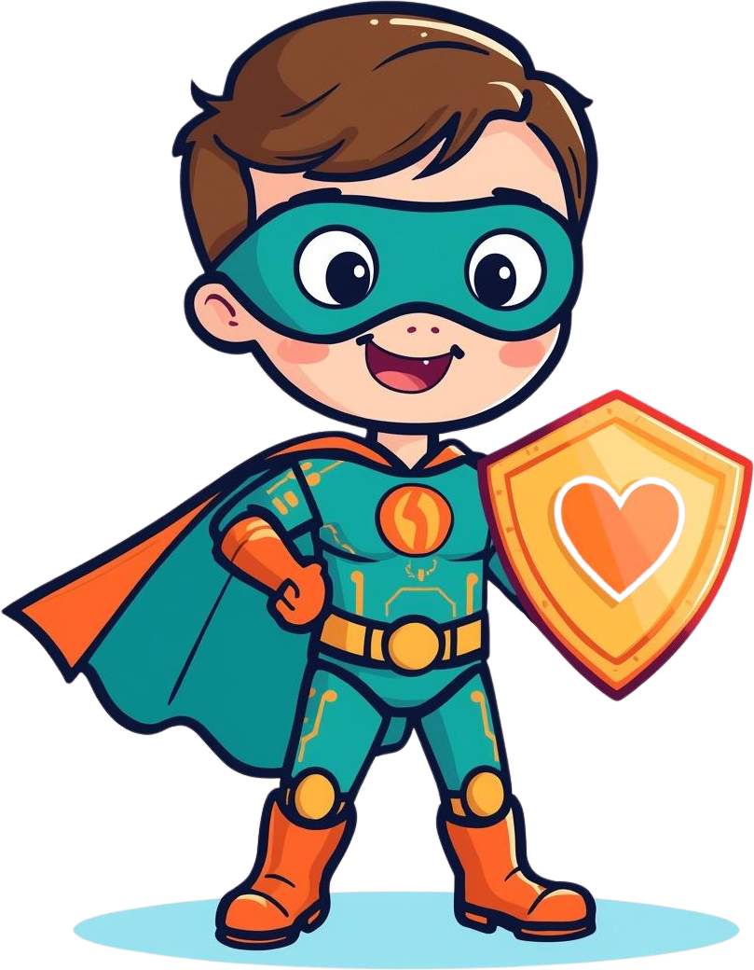
Be Fair
Be Honest
01
02
Treat others how you want to be treated. Use AI to include everyone and make sure no one is left out. Fair superheroes share and play nice!
Don't spread false information or rumors. Always check if something is true before sharing. Honest superheroes tell the truth!
Protect Privacy
Be Kind
03
04
Keep your secrets safe and respect others' privacy too. Never share passwords or personal info. A true hero guards what's important!
Use AI to help and support friends and family. Spread positivity and encouragement online. Kind superheroes lift others up!
How to Be an AI Superhero

Slide 5
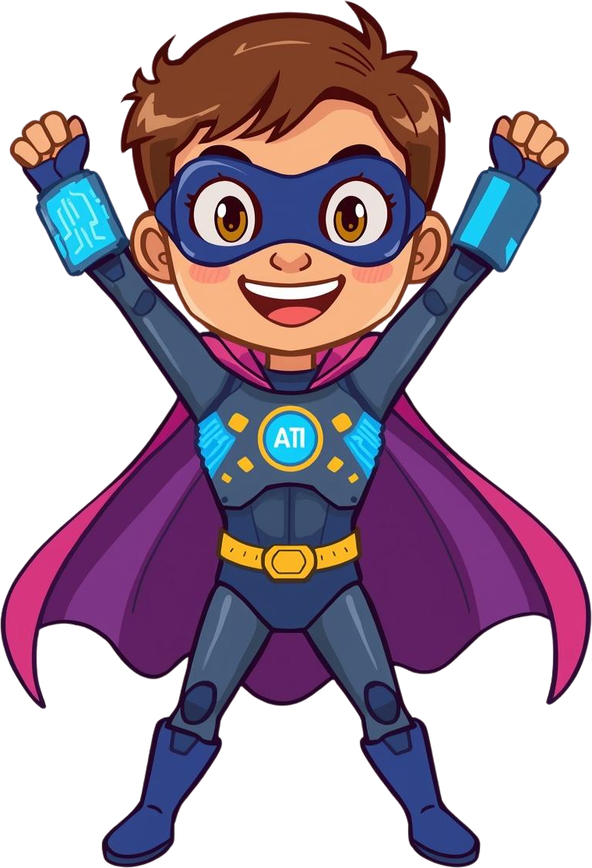

Your Mission: Use AI Responsibly!
Are you ready to be an AI Superhero?
Use your powers to make the internet safe and fair for everyone!
Being responsible with AI is the coolest superpower!
Let's be AI Superheroes together!

